Slide 1


USDA – U.S. FOREST SERVICE
IIPA
VIPR NextGen
Registering and Logging in as a Vendor Guide

Slide 2
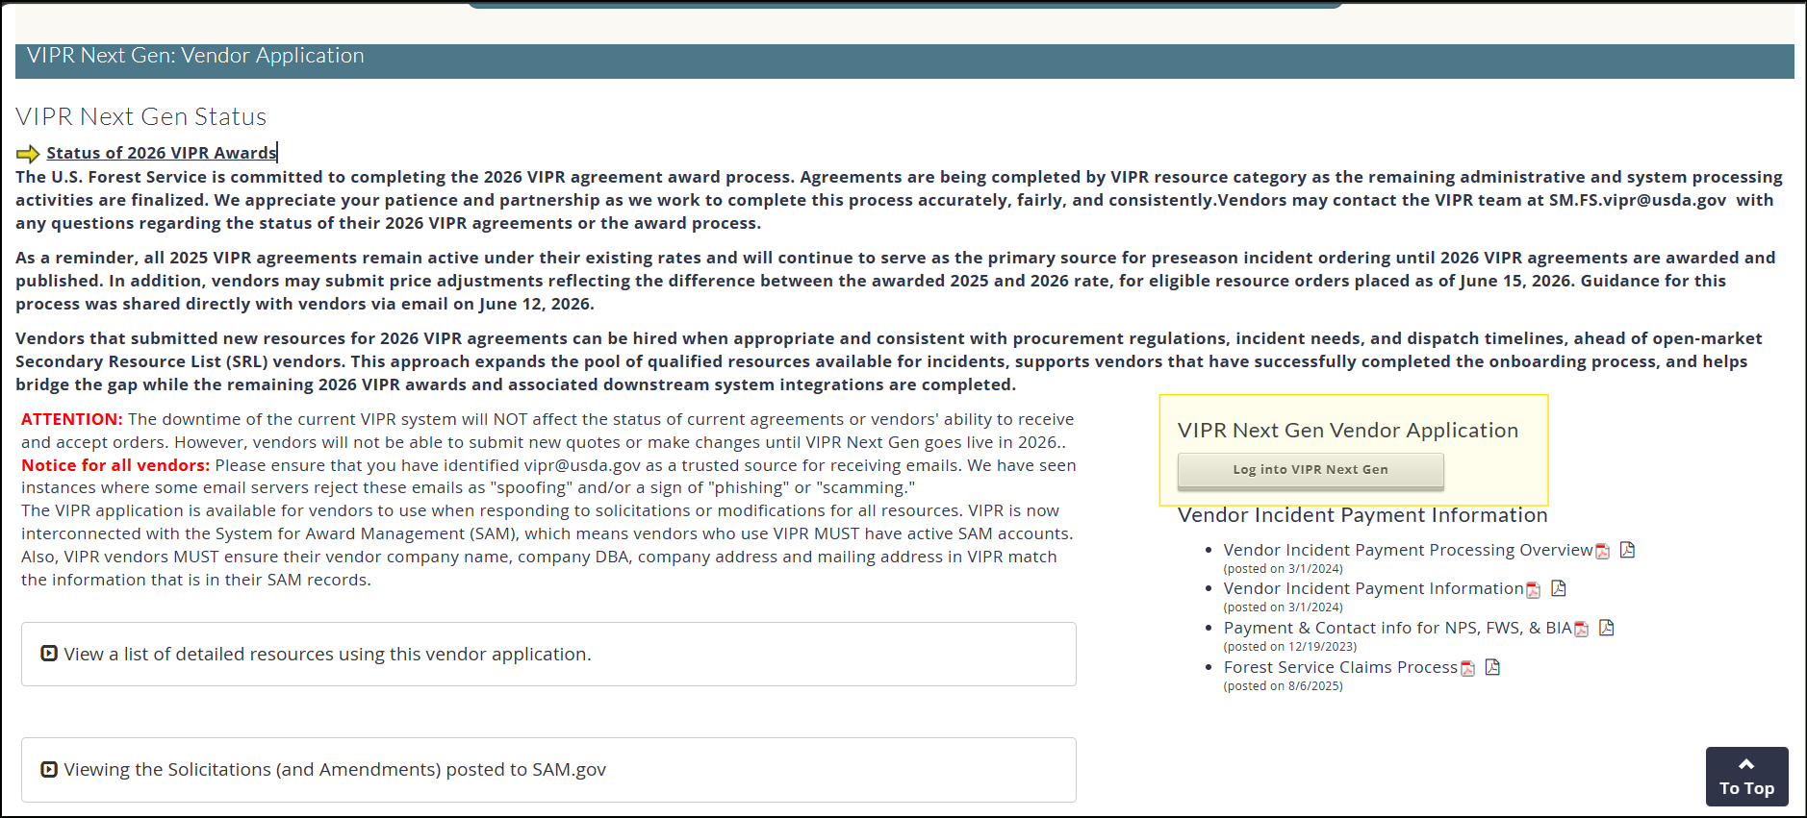
Registering and Logging in as a Vendor Guide
Register as a vendor
Navigate to the Vendor Application page, and locate the "Log into VIPR Next Gen" link about half way down the page. Click the Link

Slide 3
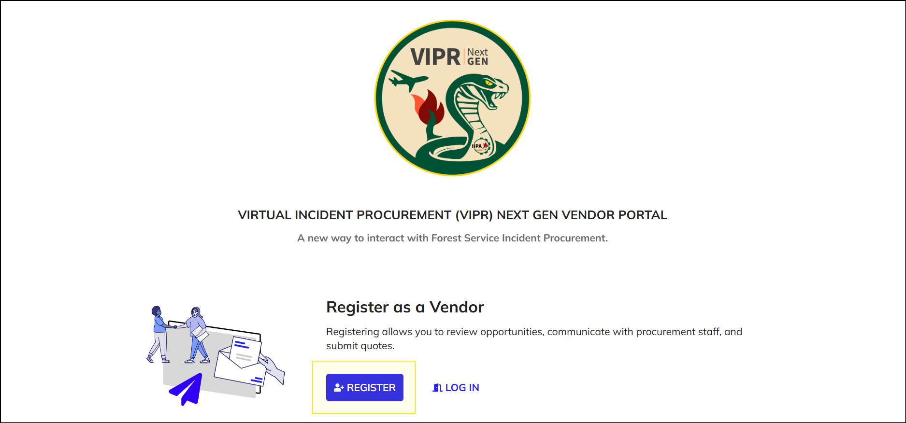
Registering and Logging in as a Vendor Guide
Register as a vendor
Click the "Register" button.

Slide 4
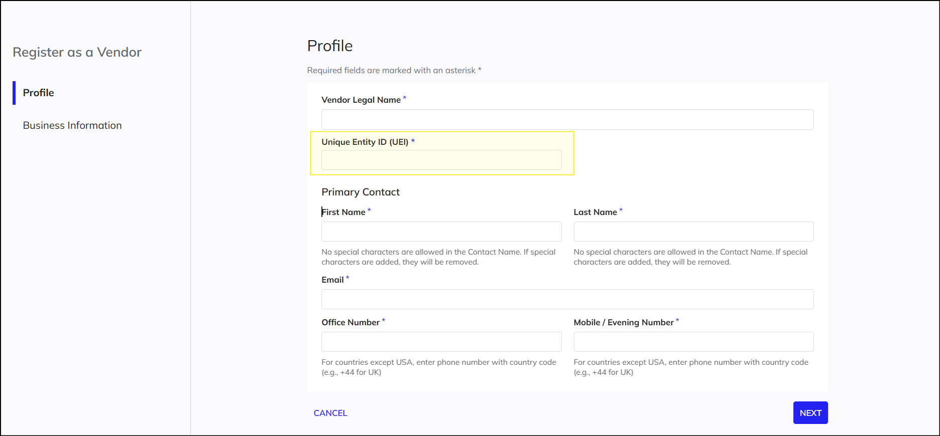
Registering and Logging in as a Vendor Guide
Register as a vendor
Paste your UEI from SAM.gov in the "Unique Entity ID (UEI)" field and tab out of the field.

Slide 5
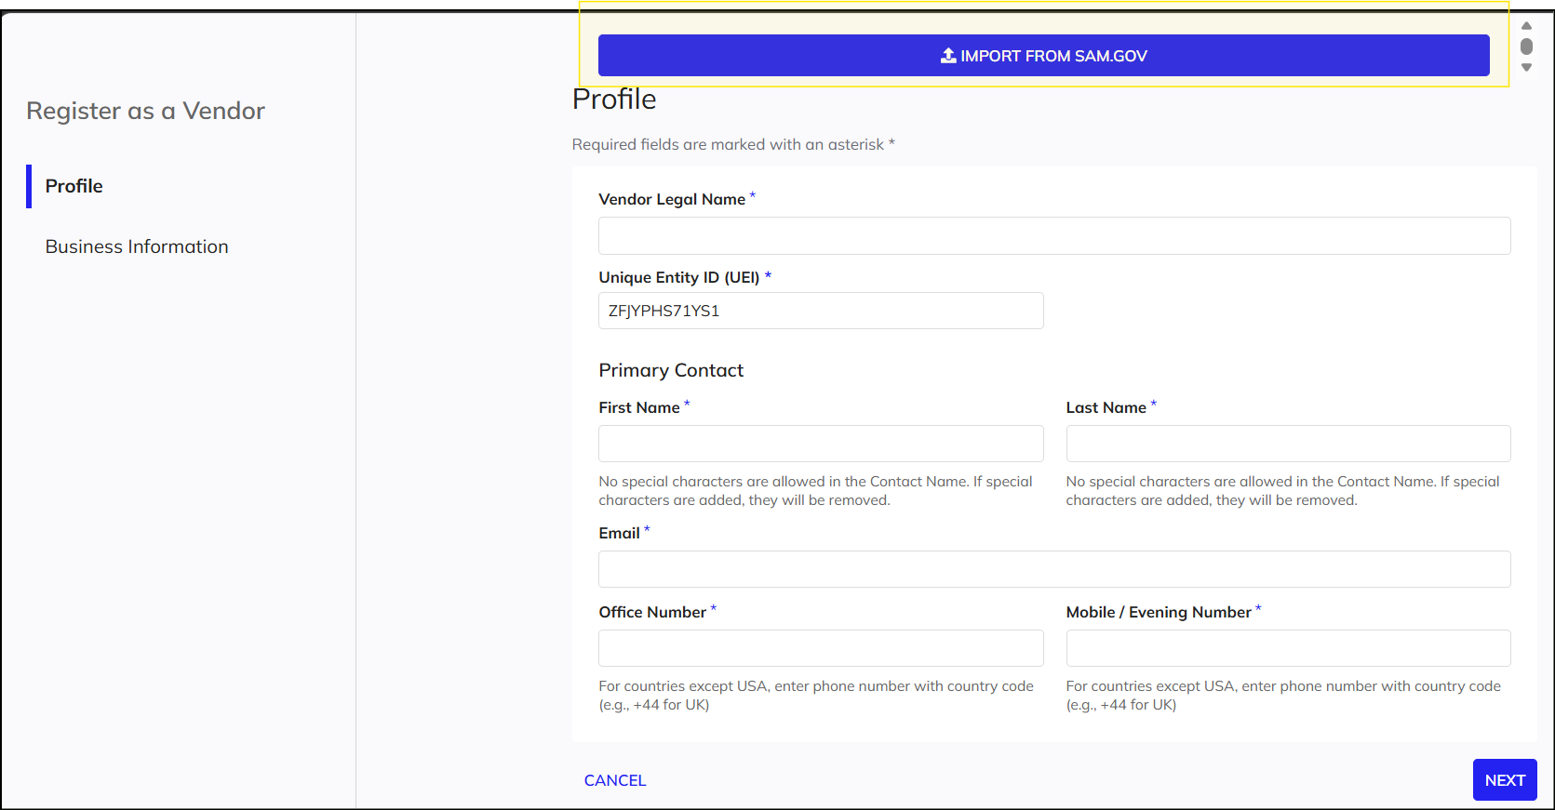
Registering and Logging in as a Vendor Guide
Register as a vendor
Click the "Import from SAM.gov" button. This will pull in your company information from SAM.gov. Review the information to make sure it is accurate.
Fill in all of the required fields on the Profile and Business Information pages.

Slide 6
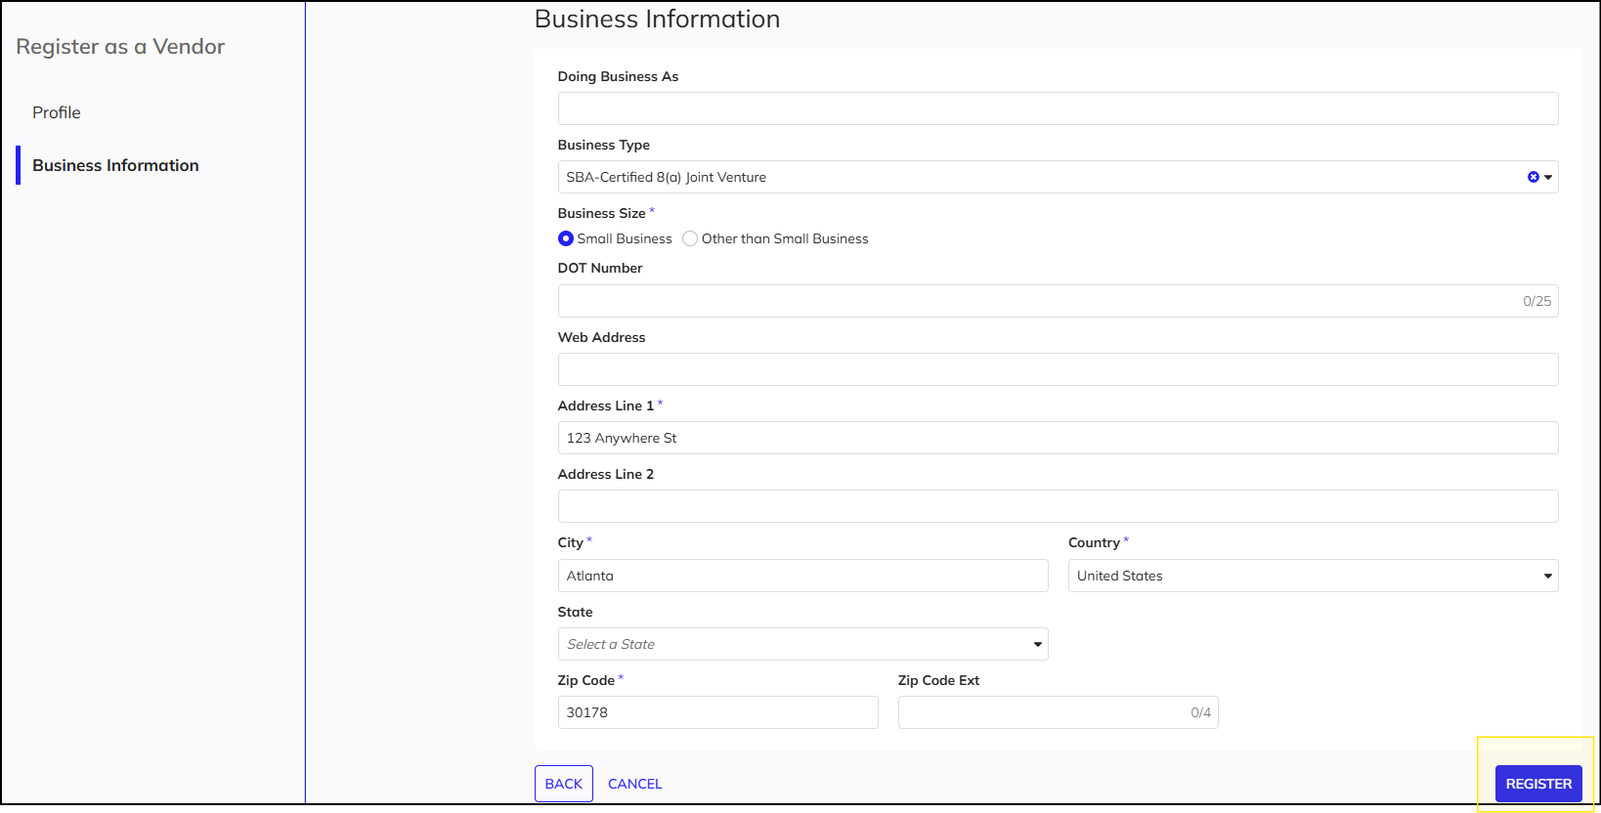
Registering and Logging in as a Vendor Guide
Register as a vendor
Once all of the information is filled in and accurate, click "Register."

Slide 7
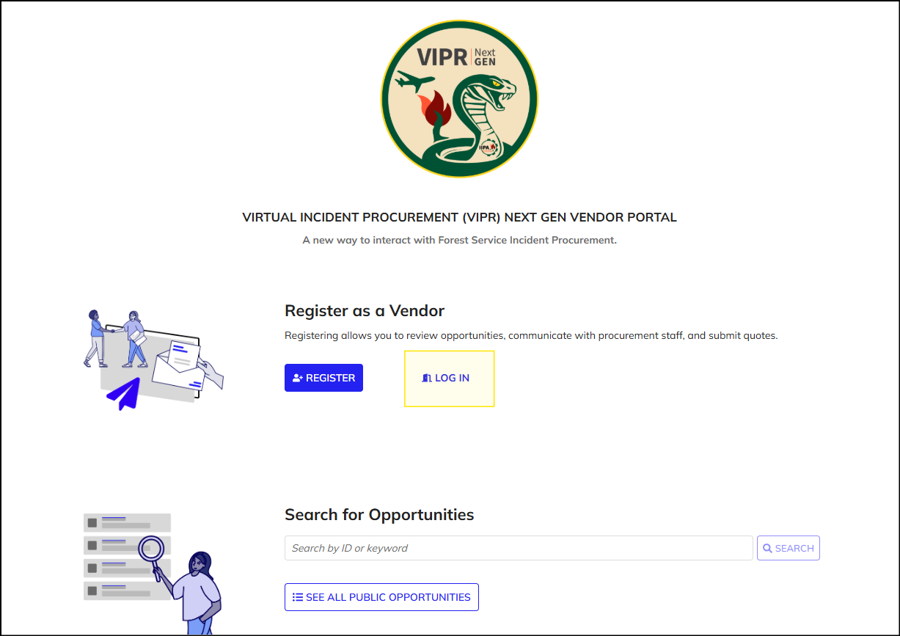
Registering and Logging in as a Vendor Guide
Log in as a vendor
Navigate to the Vendor Portal. Click the "Log In" button.

Slide 8
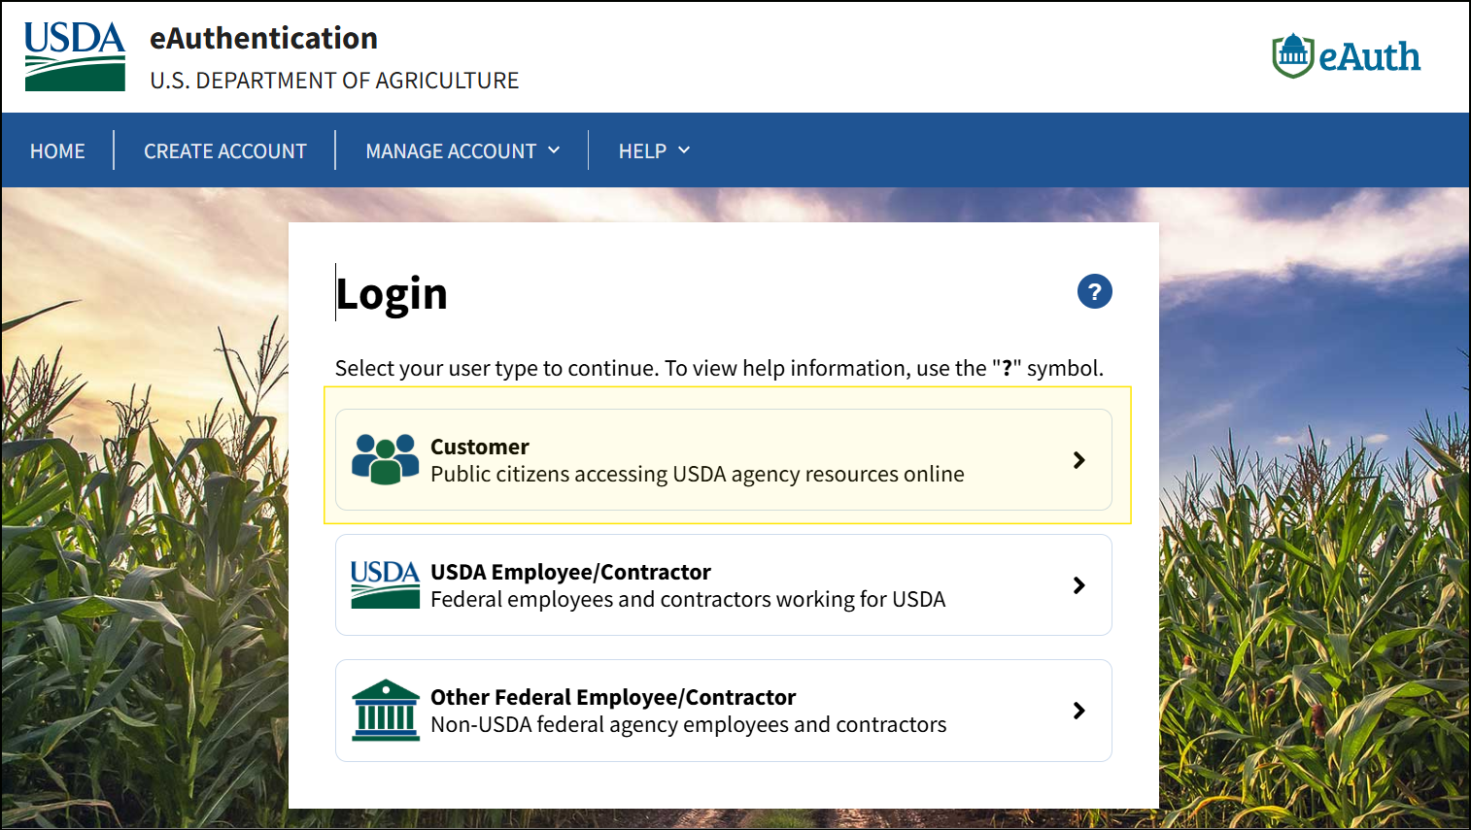
Registering and Logging in as a Vendor Guide
Log in as a vendor
You will be brought to the eAuthentication page. Make sure to select the "Customer" option.

Slide 9
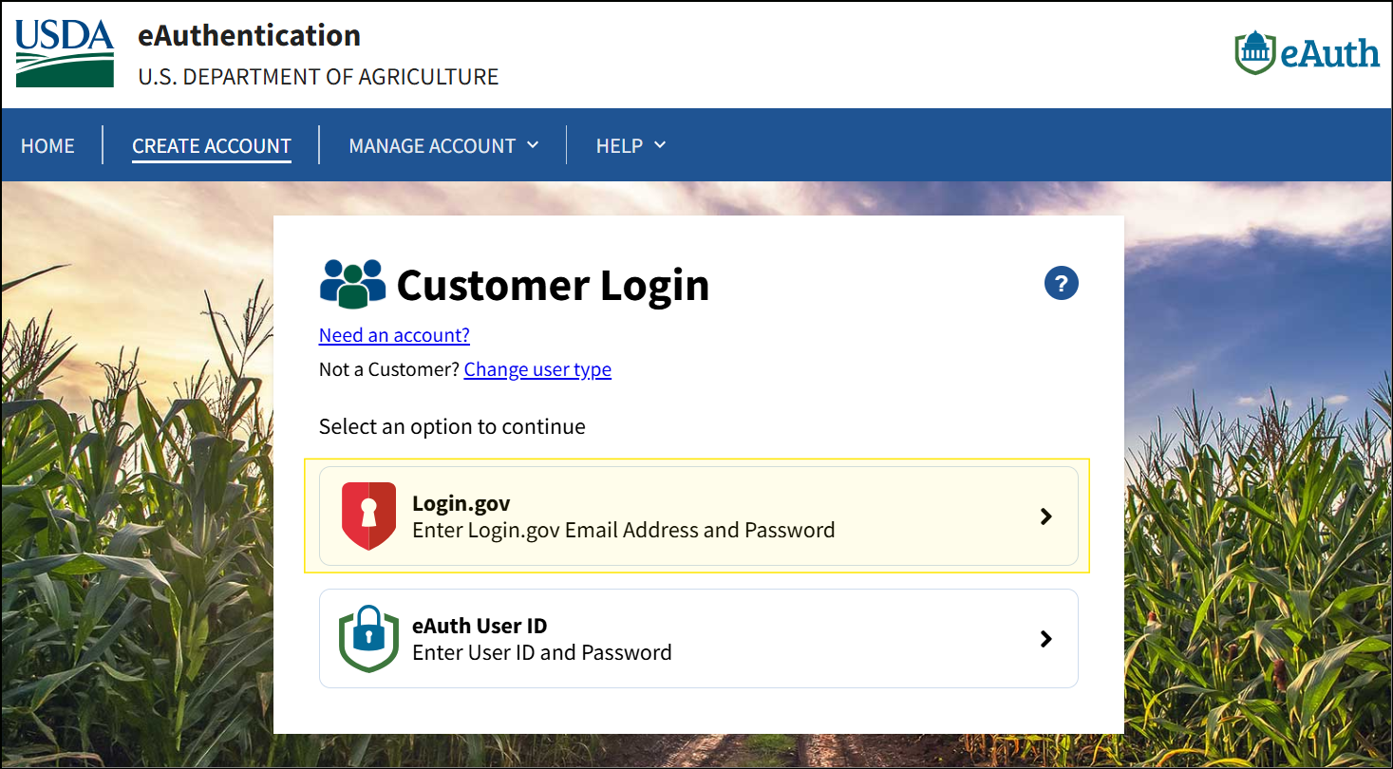
Registering and Logging in as a Vendor Guide
Log in as a vendor
Choose the "Login.gov" option.
If you do not see this option, click "Change user type" to go back to the previous page and make sure to select the "Customer" option.
Note: you MUST have a login.gov account to be able to use VIPR Next Gen as a vendor.

Slide 10
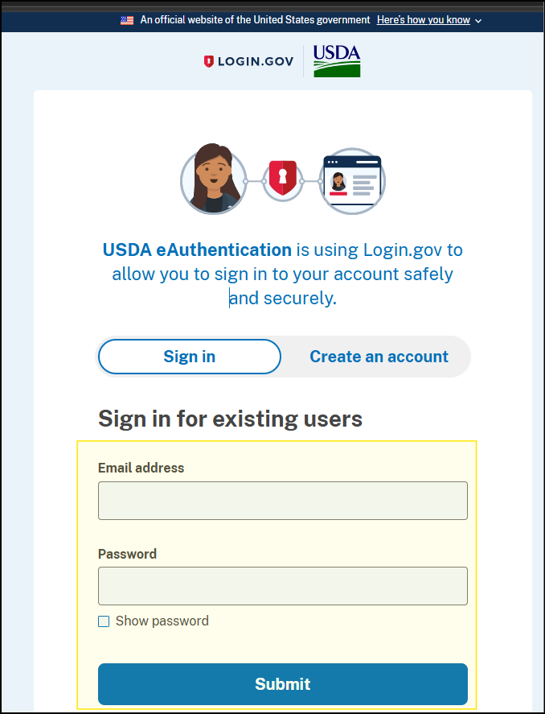
Registering and Logging in as a Vendor Guide
Log in as a vendor
Log in using your login.gov credentials.
Note: You MUST log in at least every 30 days to ensure that your VIPR Next Gen account remains active. Contact the HelpDesk if you receive a 401 error.

